Slide 1
Hopping Robot Update X
Results

Slide 2
Current Objective
Present results, complete full Pynamics model
TODO
finish collecting motor constants
maybe verify motor
verify final pynamics sim
run final pynamics sim for all designs
labeled diagram of system
frame by frame of one design

Slide 3
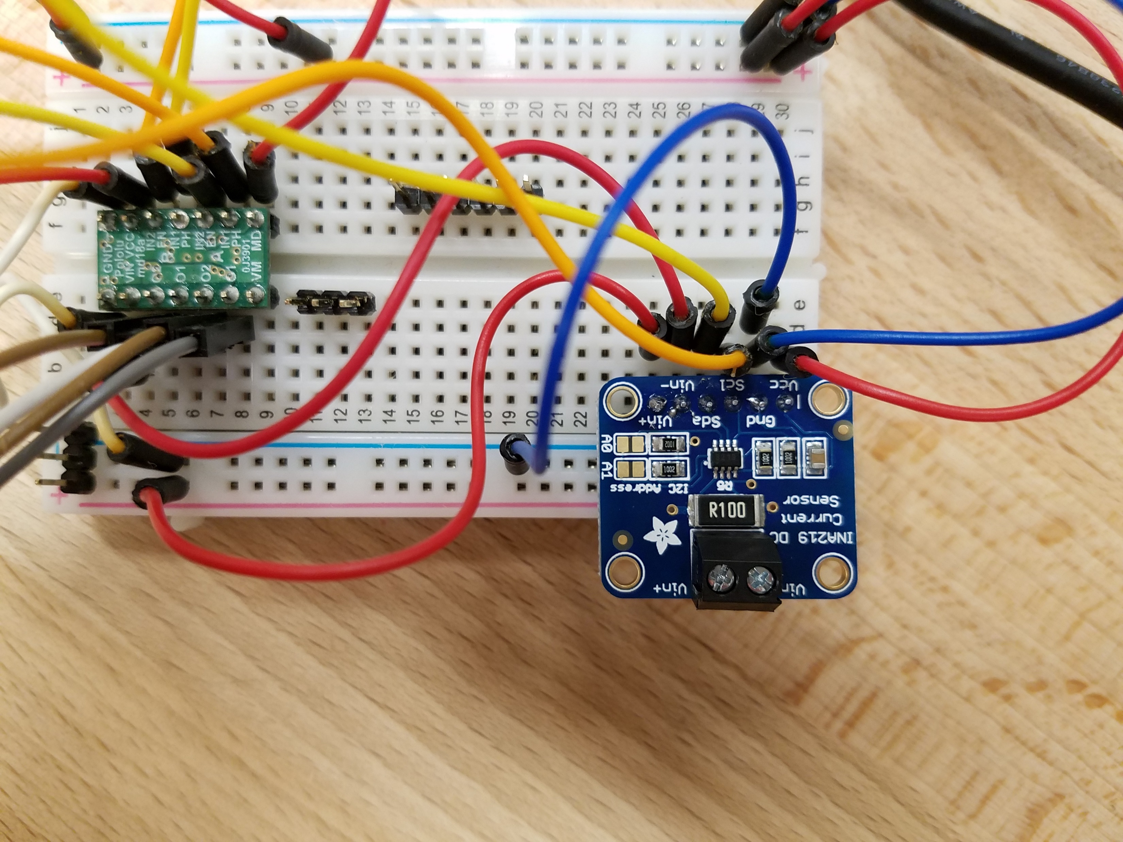
Voltage/Current Sensor
Data collection working

Slide 4
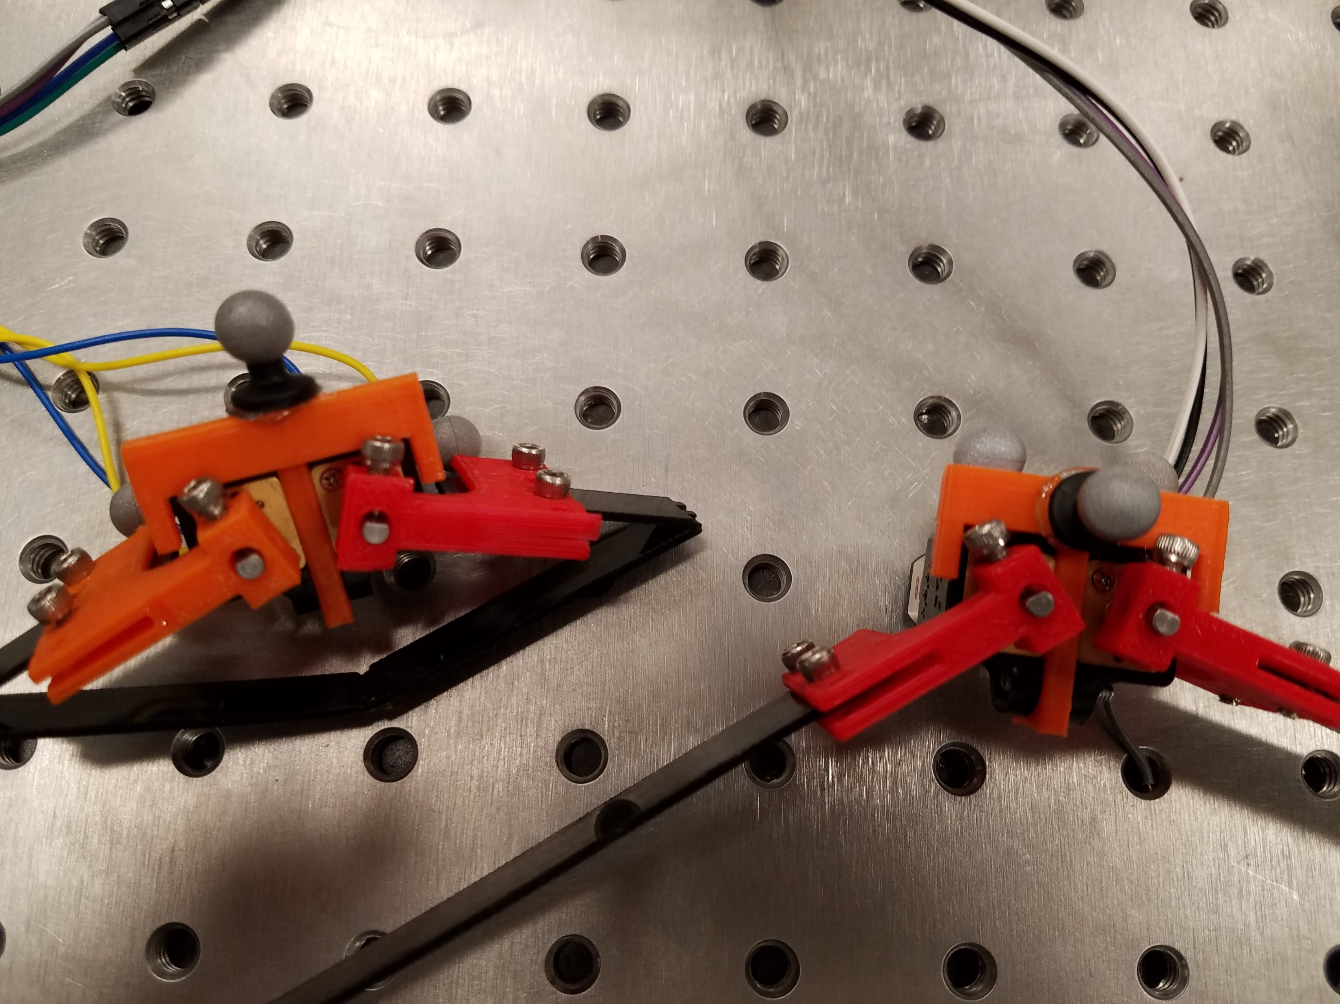
Camera Markers
Add to bottom of leg (flat foot section) to measure height above ground

Slide 5
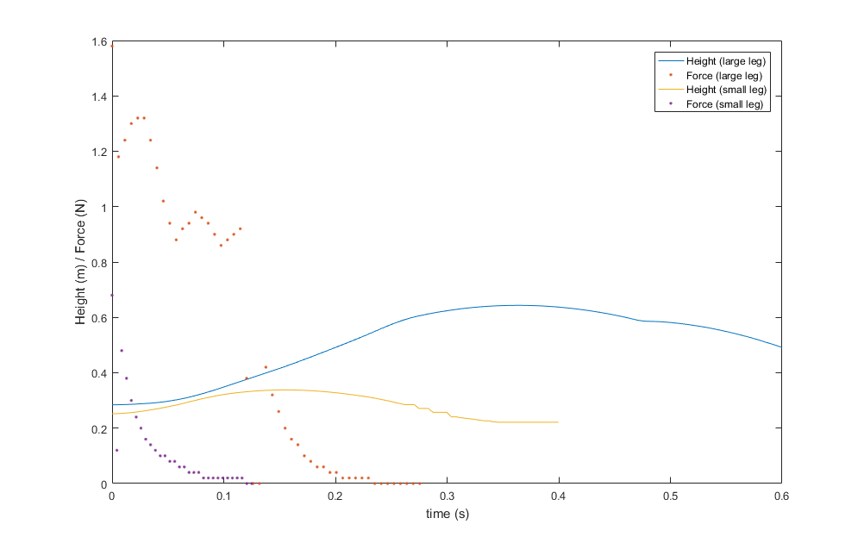
Results

Slide 6
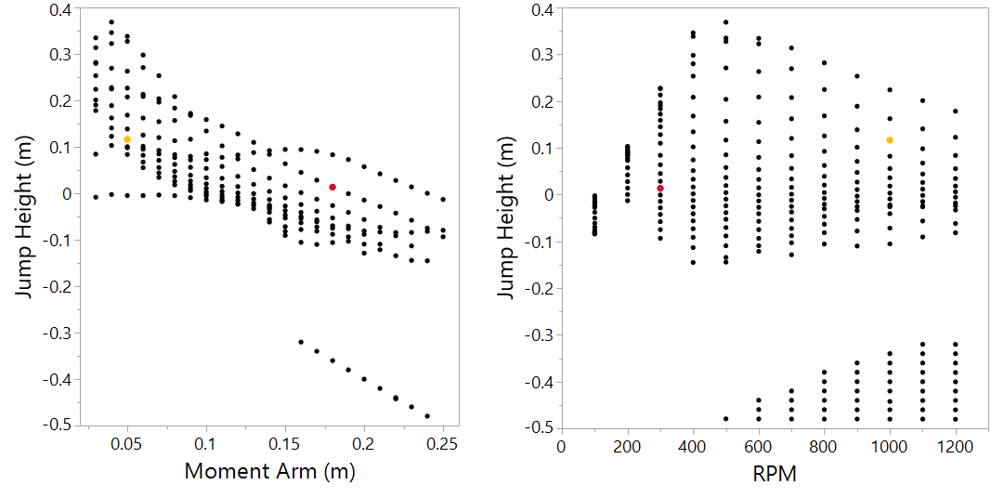
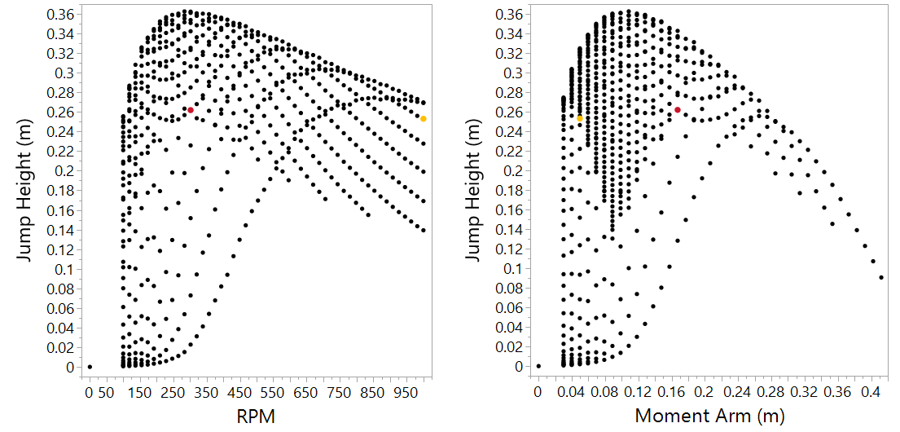
Simulation
Unity Multi-body
MATLAB Single-body

Slide 7
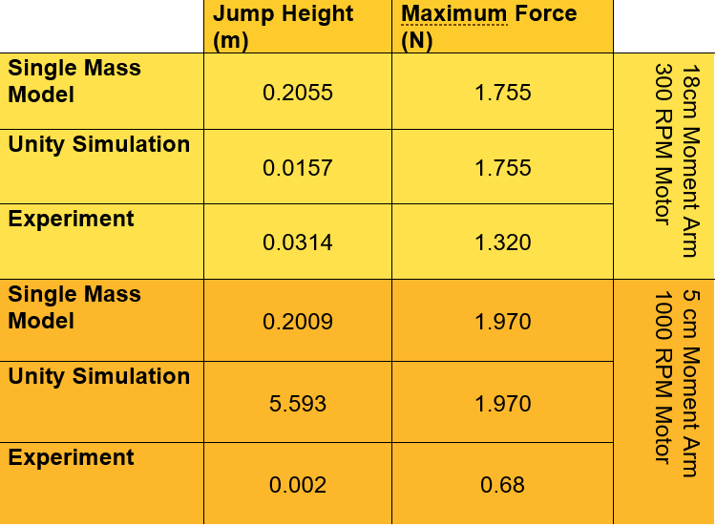
Comparison

